Slide 1
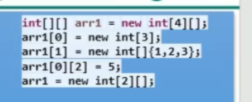
5
arr1[0] 0x553dc
arr1[1] 0x35ce
null
null
null
0 | 0 | 0 | 0
1 | 2 | 3
null
null
null
arr1 0x23ed
arr1 0x48da

